Slide 1

Training Cycles and workouts
Kyle Trelka

Slide 2
Agenda
Introduction
Swim Career
Setting up a season
A look at 3 past seasons and their plans
Taper Plans
Conclusion
Questions

Slide 3
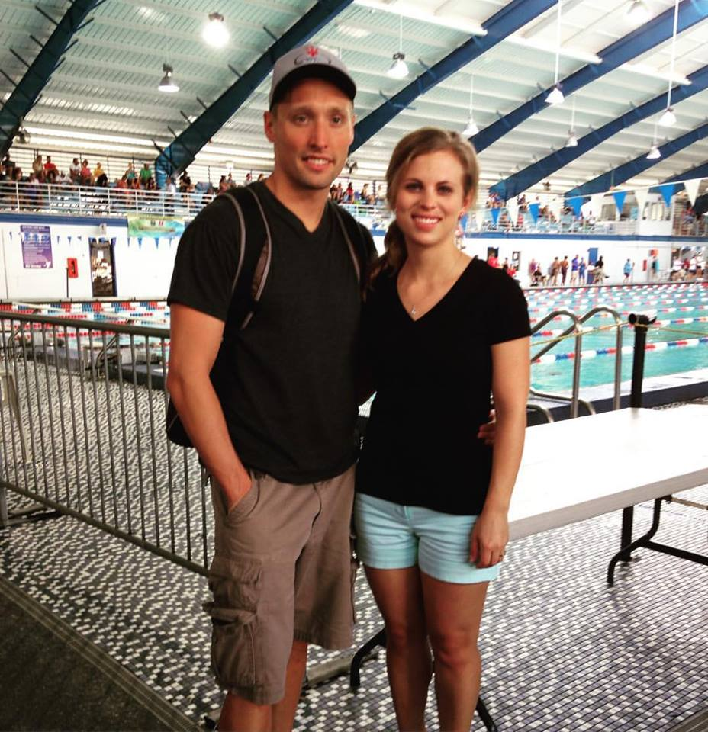
Introduction to Kyle Trelka
Come from a big family
Born in Colorado
Grew up in Wisconsin
Worked two years corporate in Nebraska
Head Coach Clearwater High School 3 seasons
Club Coach 3 years
Married
Like to hunt and fish

Slide 4

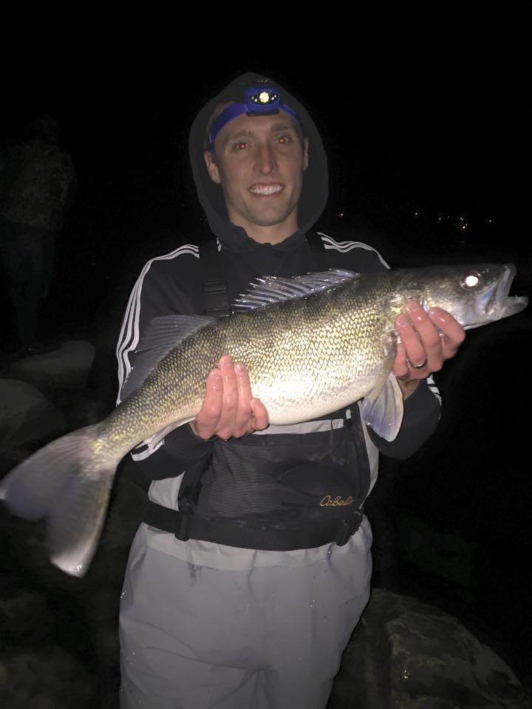
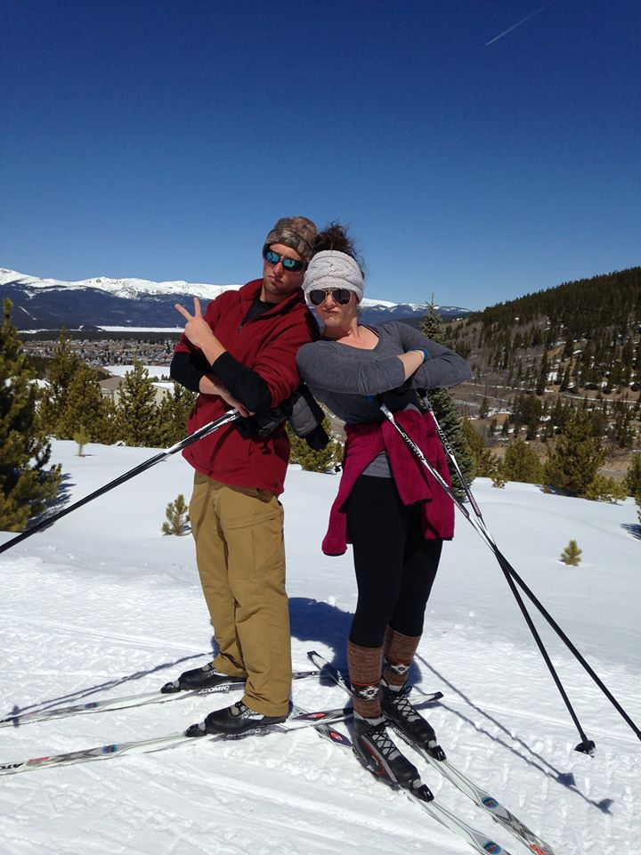
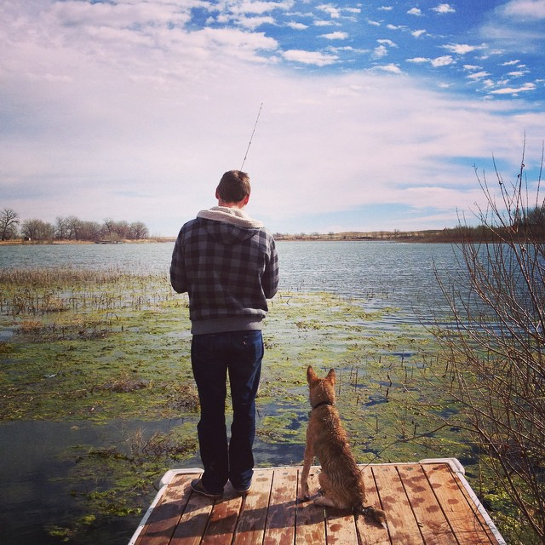
Photos

Slide 5

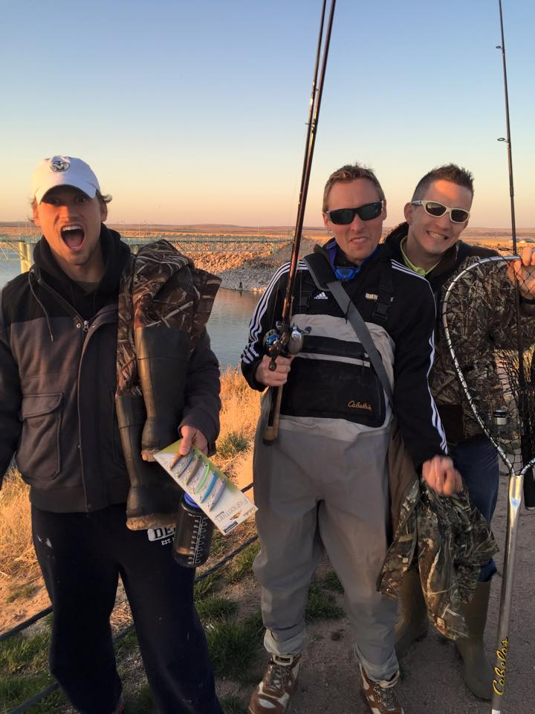
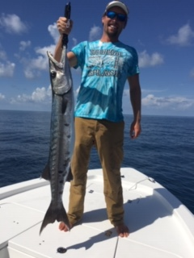
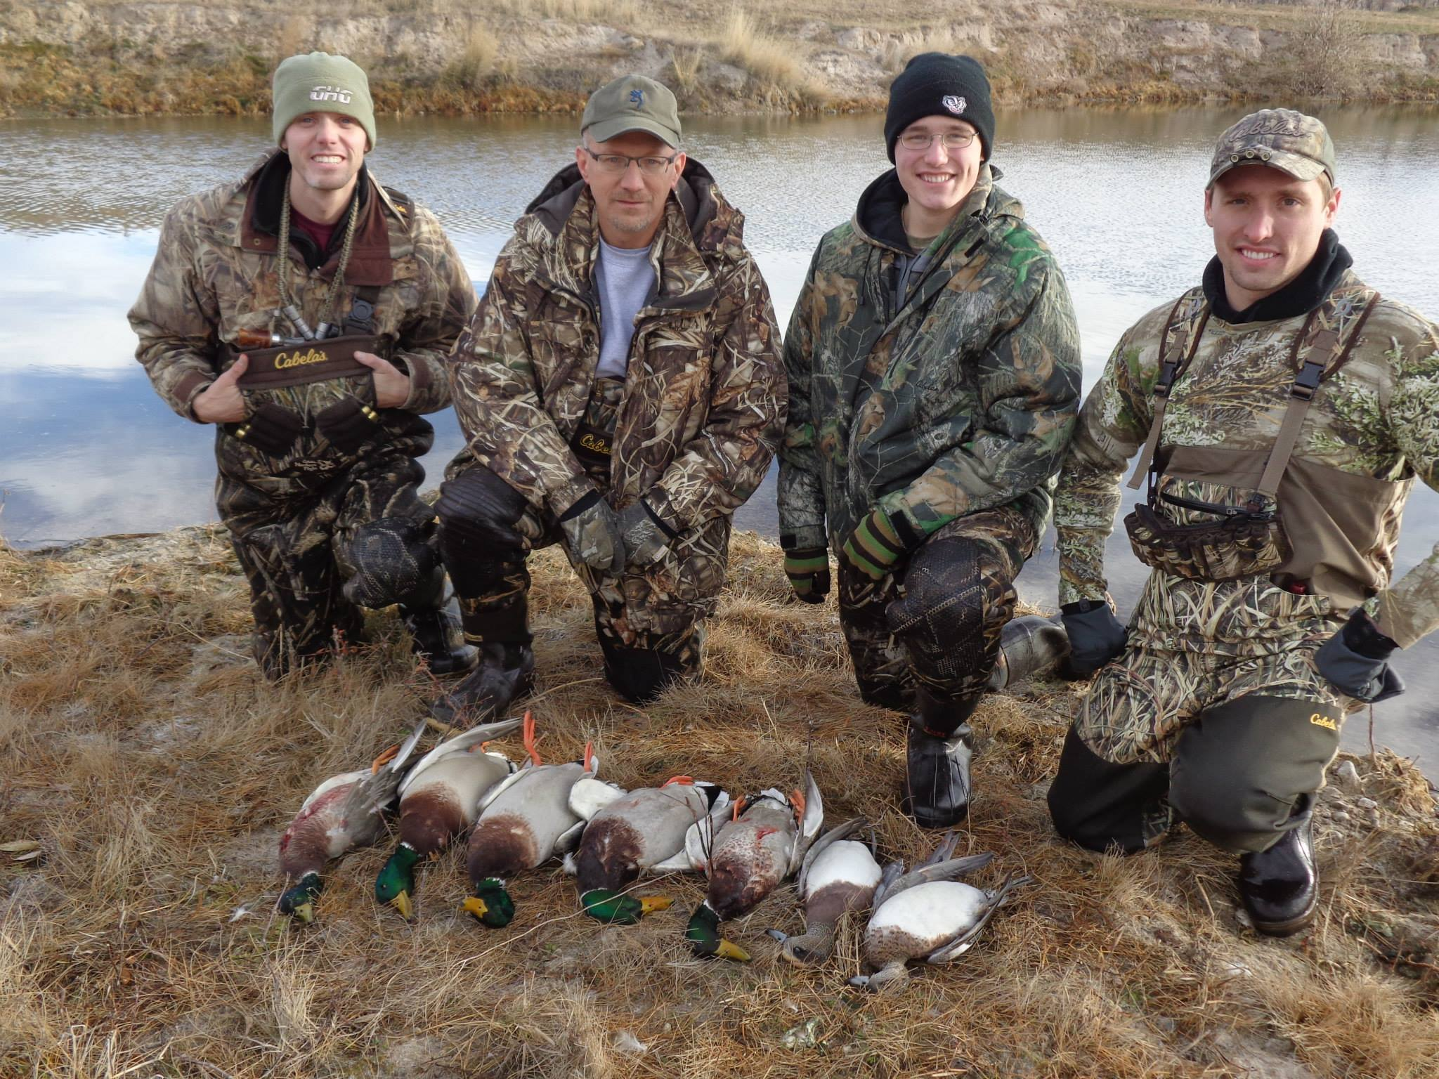

Slide 6
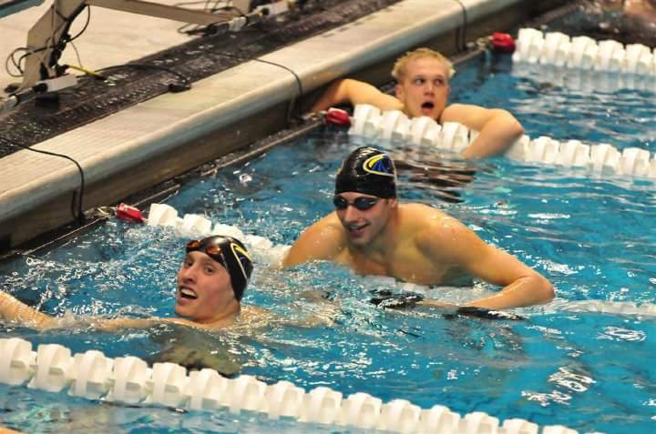
Swim Career – Where many of my coaching ideas and thoughts come from
Started in Swim Lessons
Ranked top 16 in nation as YMCA age group swimmer
A-finalist at YMCA Spring Nationals in high school
WI high school Division 2 State Champ 100 free and 100 back
NCAA D1 scholarship swimmer UW-Milwaukee
5 different coaches in high school, 3 different head coaches in college + 3 summer club coaches
Trained to make 2016 Olympic Trials
Currently training for 2020 Olympic Trials
Type A swimmer (Gary Hall Article https://swimswam.com/path-path-b-swimmer/)

Slide 7
Recap on Seasons I’ve swam
Age Group
  Lots of technique – summer nearly solely technical based off Australian Swimming Theories
  Great as 8 and under
  10 year-old year was best year
  11-12 struggled
High School
  Swam great freshman and sophomore year
  Over-trained junior year
  Hardly trained senior year and did well
College
  Swam great as a freshman
  Over-trained sophomore, junior, and senior years with little variation in workouts or seasonal structure from year to year

Slide 8
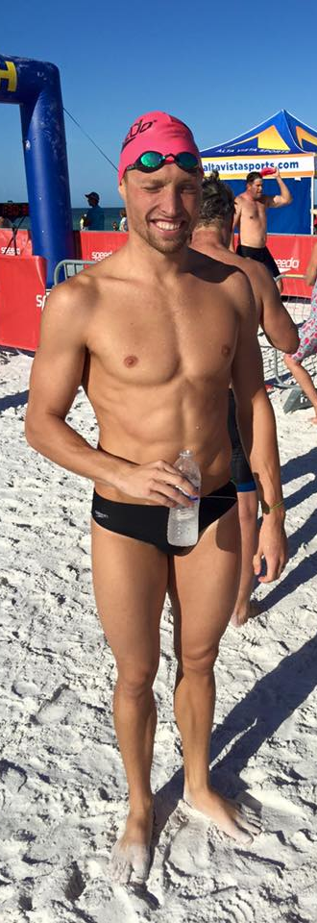

Recap Cont.
2016 Training (pictured)
  11 x two hour swims per week + 3-4 days dry land
  Technique went to junk, too tired
  Frustrating results
  Went 20.5 from a dive 2 weeks after final meet
2020 Training – for 50 free and 100 breast
  3 x one hour swims per week
  3 x one hour dry land per week
  3 x one hour weights per week
  Swims thus far have all been high-intensity but coach constantly on me about having great technique
  Dry land and weights will go hard several weeks then easy for several weeks
  Feel great
  This is my 21st year of competitive swimming
11 days straight of training After some recovery

Slide 9
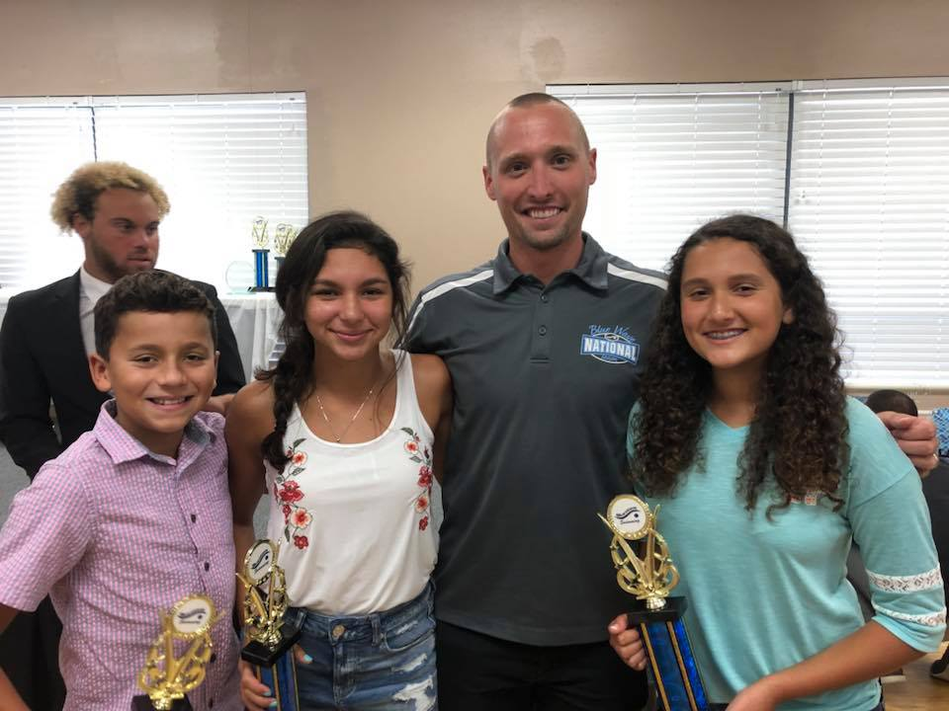
Coaching
Young coach so not a ton of history yet but…
Club
  Swimmers graduate high school with a love for the sport and not burnt out
  14 seniors from club graduated last year, 9 of whom are still swimming
  Not a huge team but high-level athletes
High School
  About 25 swimmers each season
  Have had 7 individual A-finals swims at FHSAA HS State Meet
  2 state championship titles in individual events
  80%+ of taper times have been best times every season

Slide 10
Setting up a season
Plan! Get what you want to do down on paper. It will not be exactly what you planned day to day but that’s what coaching is for.
Pick a parameter to focus on
  Yardage
  Time
  Stress level
Plan mesocycles with recovery
  Typically 10-15% more on build weeks
  Rest weeks or days bring down to 60% ish
Change regimen/parameters from season to season
(Typically) See a season through
Recap the season with numbers, other coaches, and swimmers

Slide 11
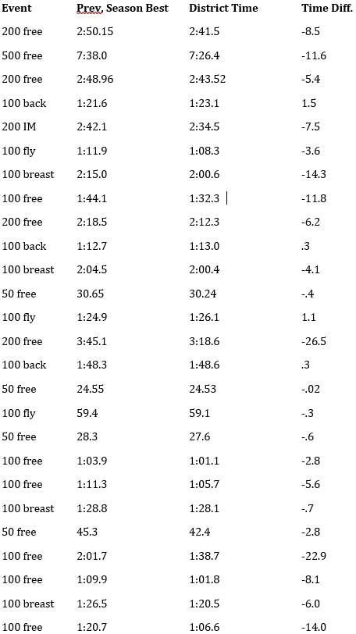
2018 HS Season
Parameter - Focused on threshold (Zone 3, HR 180)
Most mesocycles were 5 weeks (3 build, 2 recovery)
 | Monday | Tuesday | Wednesday | Thursday | Friday | Saturday
AM | 5:30-6:30 swim | 5:30-6:30 weights |  | 5:30-6:30 weights | 5:30-6:30 swim | 8-9 weights 9-11 swim
PM | 2-3 dry land 3-5 swim | 2-3 dry land 3-5 swim | Meets | 2-3 dry land 3-5 swim | 2-3 team building

Slide 12
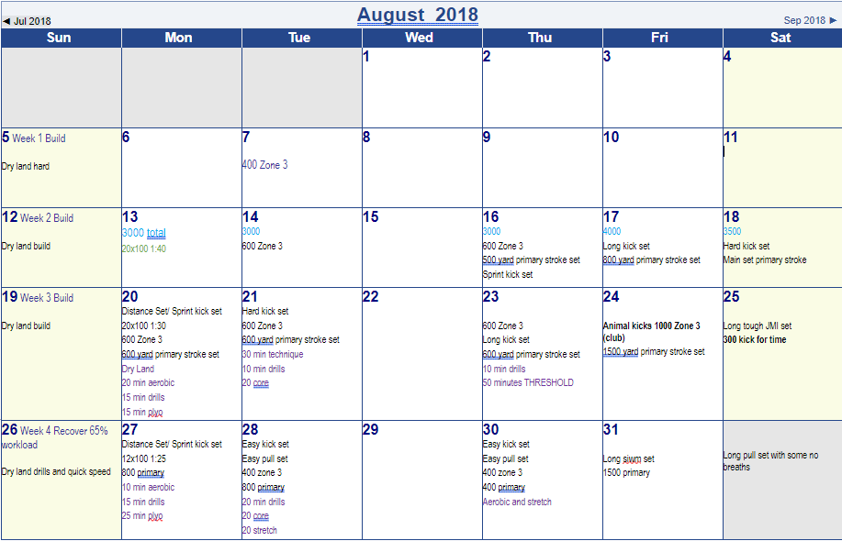

Slide 13
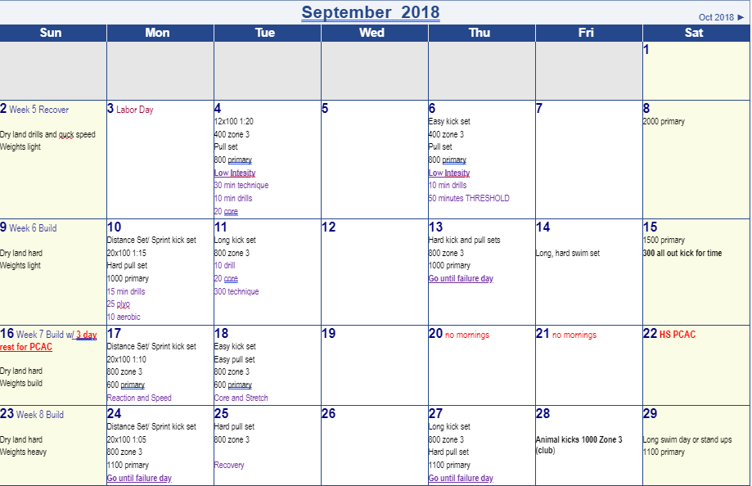

Slide 14
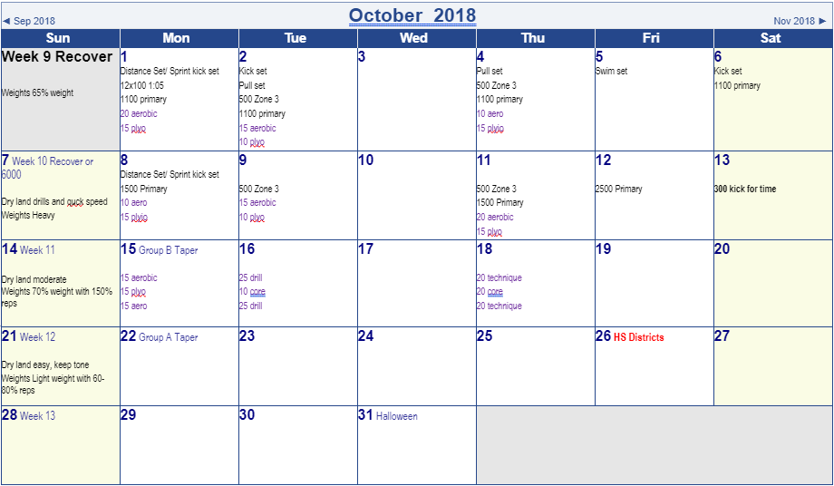
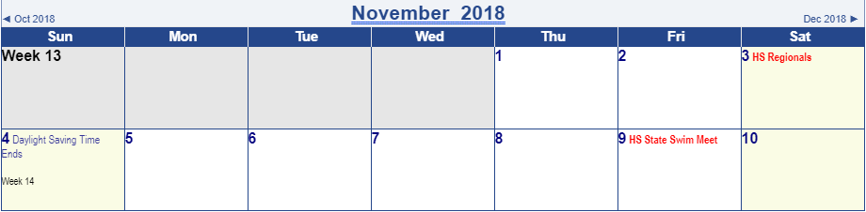

Slide 15
2018 HS Season Recap
New and Mid-level swimmers swam incredible at end of season taper meet, 29 of 33 best times with huge time drops
High-level swimmers
  Fantastic mid-season 3 day rest meet
  Not great at end of the season
Why?
  I believe by doing so much hard threshold training it gave the kids who do not always give their best in practice or don’t come to every practice more opportunities to go hard.
  The high-level swimmers know how to push their body to it’s limit more consistently and therefore were extremely broken down and tired at the end of the season
  Personal trainer/body builder running weights – high intensity with wide variety of excercises
Moving forward I would rest the high-level swimmers longer at the end of the season and/or do no zone 3 training during the recovery times.
Great training plan for new and mid-level swimmers

Slide 16
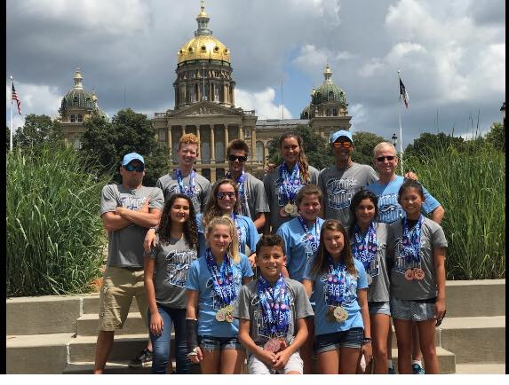
2018 club summer season
Parameter - yardage
Most mesocycles were 5 weeks (3 build, 2 recovery)
Lots of technique in the 2nd swim
 | Monday | Tuesday | Wednesday | Thursday | Friday | Saturday
6 hour workouts | 6:30-8:30 swim 9-10:30 dry land 11-12:30 swim | 6:30-8:30 swim 9-10:30 weights 11-12:30 swim | 6:30-8:30 swim 9-10:30 dry land 11-12:30 swim | 6:30-8:30 swim 9-10:30 weights 11-12:30 swim | 6:30-8:30 swim 9-10:30 games 11-12:30 swim | Off
 | Monday | Tuesday | Wednesday | Thursday | Friday | Saturday
Typical Week | Aerobic (long yardage) | Stroke sets Zone 3 | Stand up set (racing) | Recovery | Goal set | Off

Slide 17
Plan going into 2018 Summer
Weeks 1-3 aerobic and technique mainly, kids still in school but built good base going into summer, 3500-5500 yards in 2 hour swim
Week 4 Recovery – 5,000 yards each day (*3.5 hours of swimming from here to taper)
Week 5 Recovery – 5,000 yards each day
Week 6 Build – 7,500 yards each day
Week 7 Build - 8,500 yards each day
Week 8 Build –10,000 yards each day
Week 9 Recovery – 5,400 yards each day
Week 10 Recovery - 5,400 yards each day
Week 11 – 6000 yards long easy swim in morning every day, technique afternoon with nothing very hard
Week 12 - Taper
Week 13 - Taper

Slide 18
2018 club summer season recap
All swimmers of every level swam very well at end of the season meets
End of the season 3 day prelim/finals taper meet
  Kids got faster as the meet went on each day
  Swam faster from prelims to finals nearly every race. Ran lots of other teams down in last 50m of each race.
  We placed 4th with 29 kids. 3rd had 40 kids, 1st and 2nd had 100+. Averaged most points per swimmer out of entire meet, 31 teams total.
Why?
  We had so much time in the water. Did not do tons of super hard sets, lots and lots of aerobic swimming and technique and it showed in our end of the season racing.
Kids had a blast doing camp
Several days during 10,000 yard week kids were way too tired to do full yardage so we cut it down
Great season plan when pool time is not an issue

Slide 19
2017 HS Season
Ran mesocycles based on parameters with the idea that by focusing different systems and muscle groups, the body could adapt for 3 weeks then would have to re-adapt.
Weeks 1-3 speed and technique (80% easy swimming Zone 1 or 2, 20% 25 yard or less all out sprints)
Weeks 4-6 power and technique, PCAC at end of week 6
Weeks 7-9 aerobic capacity
Weeks 10-11 anaerobic power/capacity, start taper for Districts and Regions
Weeks 12-13 taper
 | Monday | Tuesday | Wednesday | Thursday | Friday | Saturday
AM |  | 5:30-6:30 weights |  | 5:30-6:30 weights |  | 9-11 swim
PM | 2-3 dry land 3-5 swim | 2-3 dry land 3-5 swim | Meets | 2-3 dry land 3-5 swim | 2-3 team building

Slide 20
2017 HS Season Recap
Best season I’ve coached thus far for high-level swimmers
  Regional meet was lights out
  State meet was not as impressive but still very good
Mid-level and new swimmers did fine
Why?
  High-level swimmers had time to rest and recover well. Only season that I have over-rested a group though. Weight program worked extremely well and helped a ton with the limited in water time we had.
Hurricane Irma took 2 weeks out of power and technique cycle
Did very little dry land from week 5 and on due to Irma breaking our pool
Did the same weight exercises week to week during entire season. Changed focus every 3 weeks (endurance, power, speed) based off Jason Lezak article https://www.bodybuilding.com/content/weight-training-for-sprint-swimmers.html
Great season plan for high-level swimmers who consistently give great effort

Slide 21
Taper overview
Week leading into taper
  If they are tired and broken down, I like to do 6000 every day. Just long and smooth.
  If they are fresh I will give them Tuesday 12x100 1:40 hold 12-17 from best time and Wednesday 12x25 on :30 hold As Fast As You Can.
  Do dry land 2-3 days per week, 4 min on with 2 min rest.
    [ex. 2x(:30 split jumps, :30 band pull, :30 crunch, :30 squats) then 2 min rest and do 2x through so 4 (2 rounds, 2 min rest, 2 rounds) sets total] This plays into 1st week of taper for girls. Do same exercises 3 weeks out as into 1st week of taper
Taper mindset – tell athletes to swim slow and relaxed, focusing on relaxing and grabbing all molecules of water. Don’t spend much time at wall. Swim as slow as you can unless we are doing fast or build. I often yell at kids for going too fast the first week.
Do mental prep at least 4 times per week for 2 weeks leading into focus meet
Boys no dry land for 2 weeks before big meet, girls no dry land for 1 week before big meet and 2 weeks out do 2 min on 4 min rest (ex. :30 split jumps, :30 band pull, :30 crunch, :30 squats then 4 min rest and do 2x through)
Off weights 3-4 weeks before big meet

Slide 22
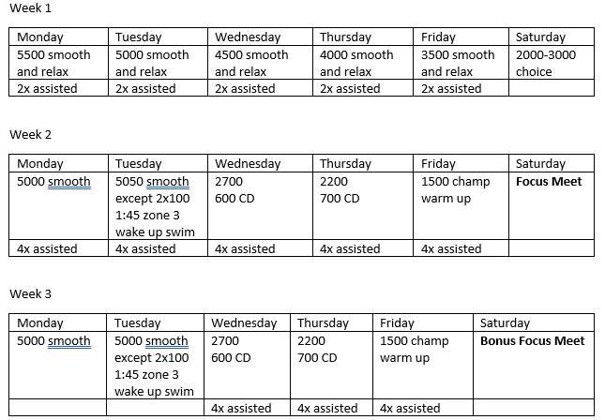
My Typical Taper (2 week)

Slide 23
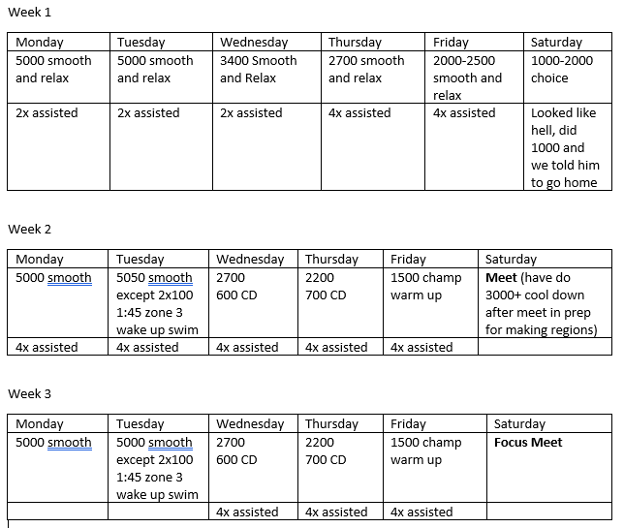
My big dog taper (3 week)

Slide 24
In conclusion
Plan but be able to adjust day to day based off what you see in your athletes
Be creative
Recovery is key
Change regimen/parameters from season to season
See a season through
Recap the season with numbers, other coaches, and swimmers
Remember seasons build on seasons

Slide 25
Questions?

